Slide 1
Top beach
Fronts Holocene forest
Erosional
n=15
Sewanee IEP
Beach Plastics
Monitoring Program
Study area
Five beaches
~ 18.5 km (11.5 miles) of beach
Assume 50m wide beach
Beach area = approx. 0.93 km²
Northeast beach
Fronts Holocene dune
Accretional
n=15
North beach
Fronts Holocene marsh & Pleistocene bluff
Erosional
n=18
Middle beach
Fronts Holocene marsh
Erosional
n=15
Cracker Tom beach
Fronts Holocene marsh
Erosional
n=15
South beach
Fronts Holocene dune/forest
Erosional
n=15

Slide 2
Top beach
Holocene forest
Erosional
Sewanee IEP
Beach Plastics Monitoring Program
Study area
Five beaches
~ 18.5 km (11.5 miles) of beach
Assume 50m wide beach
Beach area = approx. 0.93 km²
Sampling plan
20 transects per beach
Each transect is 100 m x 3 m transect (300 m²)
Total area surveyed per beach = 6,000 m²
(0.006 km²)
Grand total surveyed = 30,000 m² (0.03 km²)
Surveys will sample 3.25% of beach area
North beach
Marsh / Pleistocene
Erosional / Accretional
Middle beach
Holocene marsh
Erosional
Cracker Tom beach
Holocene marsh
Erosional
South beach
Holocene dune
Erosional

Slide 3
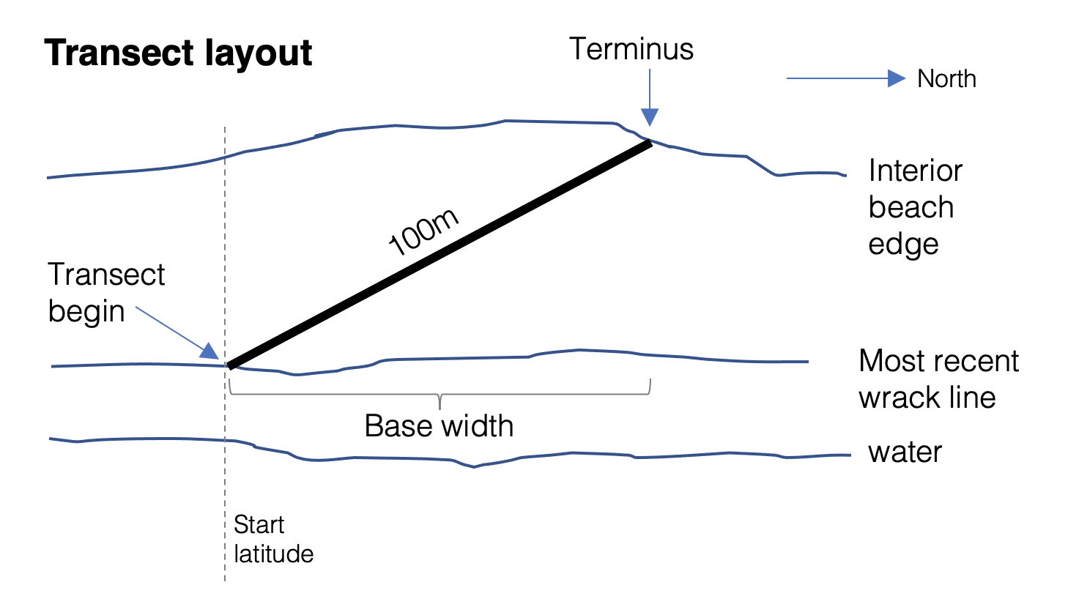

Slide 4
Transect setup
Locate the start latitude
Place flag in the most-recent wrack line
Record start longitude
Note main observer and secondary observer / notetaker
Lay out transect tape
Your transect will be 100 m long.
Angle your transect between your start point (wrack line) and the interior beach edge (terminus)
Make sure tape is straight!
Note Terminus type
Use pace or tape to determine & record the base width
Note conditions
Note start time
Start sampling!

Slide 5
Sampling procedure
Primary observer: take 3m pole and begin walking tape, searching for detection “events” within 1.5m of the tape.
Call out events for the secondary observer to record.
Call out information in the order provided in the datasheet
Secondary observer: walk behind and record data. Measure sizes of plastic pieces discovered by Observer 1.
Continue onto multiple datasheets as necessary
(be sure to note Daily Transect ID on new sheets)

Slide 6
Position (m) + Event
D = Anthropogenic Debris
WLMR = Wrack line (most-recent)
WLOT = Other wrack line
TREE = Base of beached tree
LIMB = Limb / log
PLANT = Isolated plant
* WRAK = Wrack pile (not a line)
* SHELL = Dense shell area
* PEAT = Marsh peat deposit
OTHR = Other object/obstacle
* only log once per meter
Sampling procedure
Primary observer: take 3m pole and begin walking tape, searching for detection “events” within 1.5m of the tape.
Call out events for the secondary observer to record.
Call out information in the order provided in the datasheet
Secondary observer: walk behind and record data. Measure sizes of plastic pieces discovered by Observer 1.
Continue onto multiple datasheets as necessary
(be sure to note Daily Transect ID on new sheets)

Slide 7
Position (m) + Event
D = Anthropogenic Debris
WLMR = Wrack line (most-recent)
WLOT = Other wrack line
TREE = Base of beached tree
LIMB = Limb / log
PLANT = Isolated plant
* WRAK = Wrack pile (not a line)
* SHELL = Dense shell area
* PEAT = Marsh peat deposit
OTHR = Other object/obstacle
* only log once per meter
Material
FOAM = Foam
HARP = Hard Plastic
FLIP = Flimsy / thin Plastic
PAPR = Paper
LINE = Filament line
ROPE = Rope line
FABR = Fabric / cloth
OTHR = Other
Structure
FRA = Fragment / shard
BOT = Bottle
CUP = Cup
BAG = Bag
LON = Long or tangled
NET = Net
OTH = Other in-tact
Sampling procedure
Primary observer: take 3m pole and begin walking tape, searching for detection “events” within 1.5m of the tape.
Call out events for the secondary observer to record.
Call out information in the order provided in the datasheet
Secondary observer: walk behind and record data. Measure sizes of plastic pieces discovered by Observer 1.
Continue onto multiple datasheets as necessary
(be sure to note Daily Transect ID on new sheets)
cm from tape
(estimated)
size
(in cm)
(use longest dimension)

Slide 8
Position (m) + Event
D = Anthropogenic Debris
WLMR = Wrack line (most-recent)
WLOT = Other wrack line
TREE = Base of beached tree
LIMB = Limb / log
PLANT = Isolated plant
* WRAK = Wrack pile (not a line)
* SHELL = Dense shell area
* PEAT = Marsh peat deposit
OTHR = Other object/obstacle
* only log once per meter
Material
FOAM = Foam
HARP = Hard Plastic
FLIP = Flimsy / thin Plastic
PAPR = Paper
LINE = Filament line
ROPE = Rope line
FABR = Fabric / cloth
OTHR = Other
Structure
FRA = Fragment / shard
BOT = Bottle
CUP = Cup
BAG = Bag
LON = Long or tangled
NET = Net
OTH = Other in-tact
Sampling procedure
Primary observer: take 3m pole and begin walking tape, searching for detection “events” within 1.5m of the tape.
Call out events for the secondary observer to record.
Call out information in the order provided in the datasheet
Secondary observer: walk behind and record data. Measure sizes of plastic pieces discovered by Observer 1.
Continue onto multiple datasheets as necessary
(be sure to note Daily Transect ID on new sheets)
cm from tape
(estimated)
size
(in cm)
(use longest dimension)
Key policies
Record EVERYTHING within 1.5m of tape and larger than 0.5 cm.
Walk the tape SLOWLY. Assumption is that you are not missing ANYTHING.
What about large plastic pieces beyond 1.5m, or pieces smaller than 0.5 cm?
What about extensive debris?

Slide 9
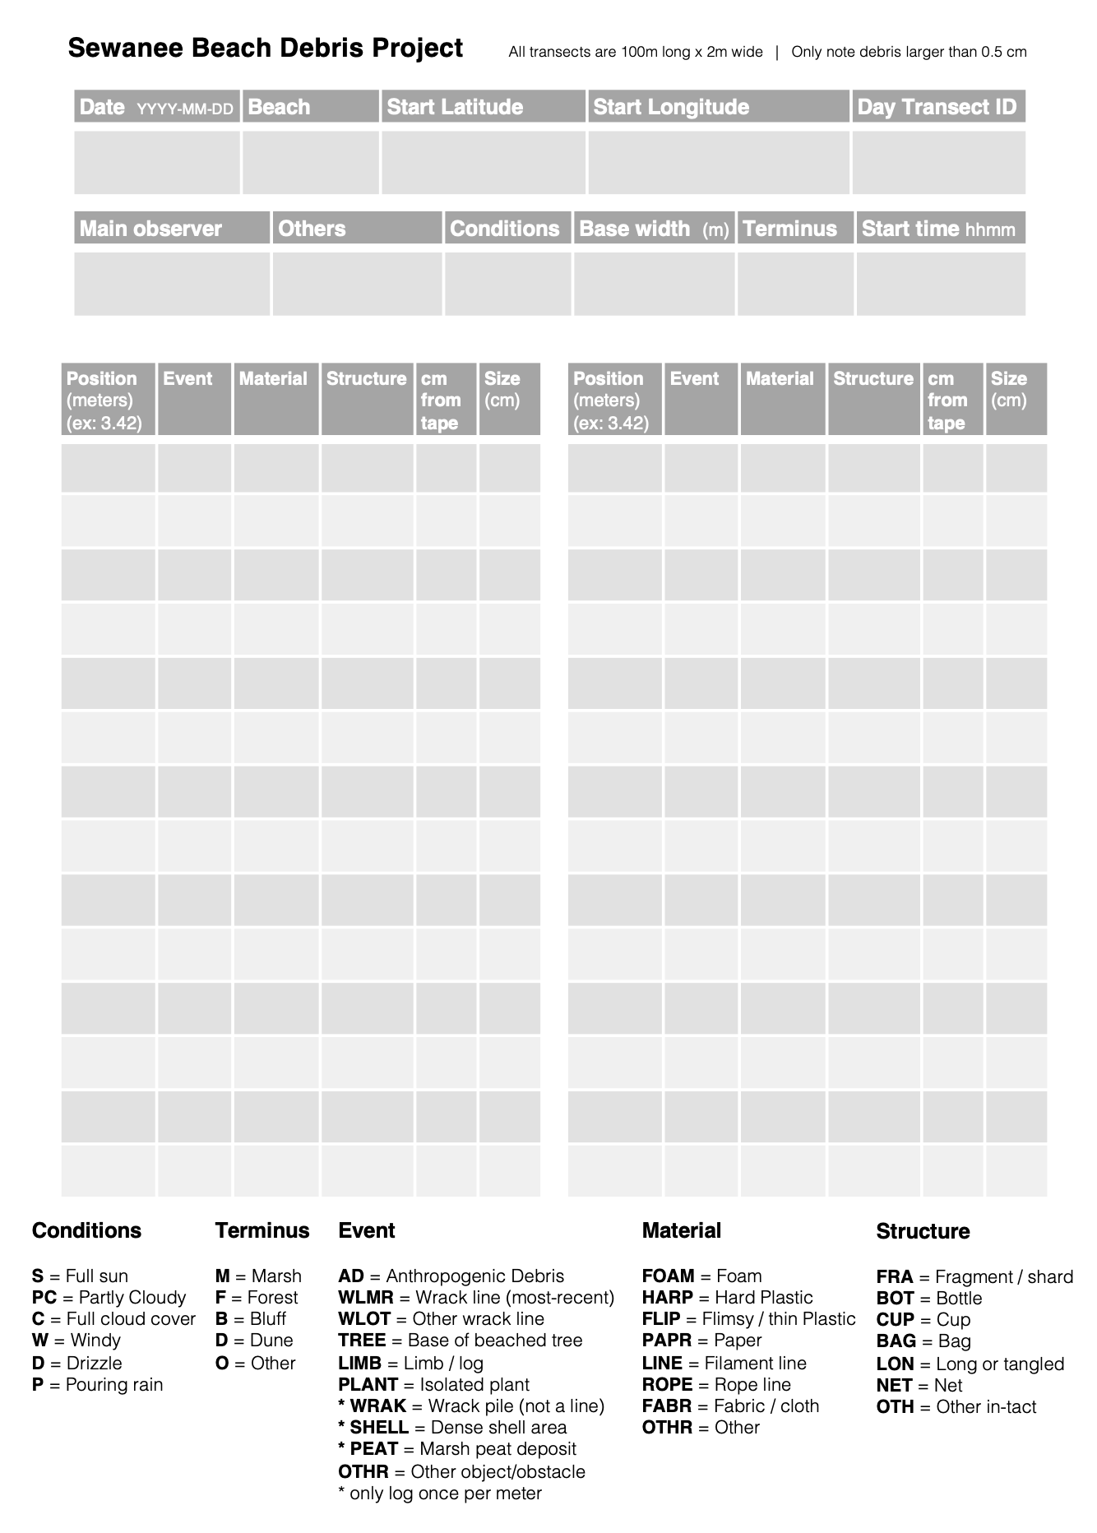

Slide 10
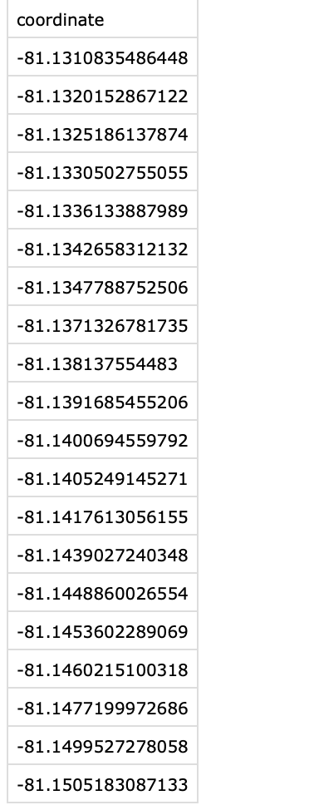
Top beach
Holocene forest
Erosional
Student project?

Slide 11
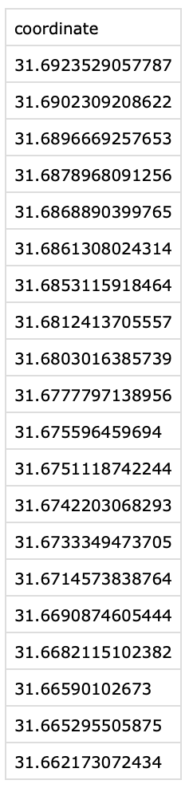

Eric
North beach
Marsh / Pleistocene
Erosional / Accretional

Slide 12
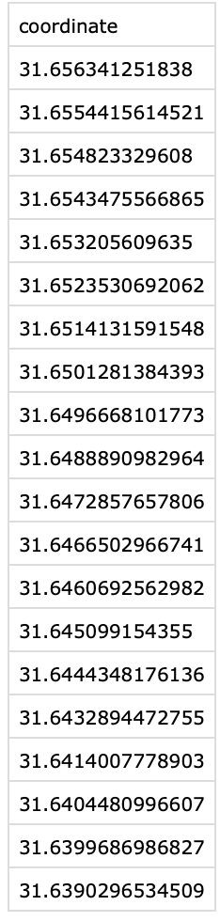
Class sampling
Middle beach
Holocene marsh
Erosional

Slide 13
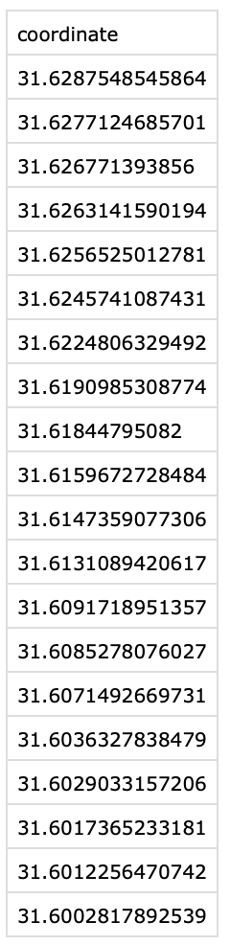
Class sampling
DONE
June 13
Cracker Tom beach
Holocene marsh
Erosional

Slide 14
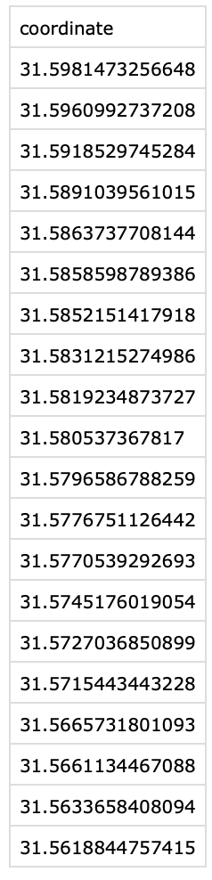
Student project?
South beach
Holocene dune
Erosional

